Slide 1
SKILL BUILDING FOR JUDICIAL OFFICERS
RESOURCE PERSON:

Slide 2
Session Objectives
To explore tools to help judges effectively deliver timely justice
Through developing more control over circumstances
Through double-loop thinking
Through a paradigm shift

Slide 3
Effectiveness by Gaining Control Over Our Circumstances
RESOURCE PERSON:

Slide 4
Discussion
Why are some people successful in the same circumstances while others fail?
Test for locus of control

Slide 5
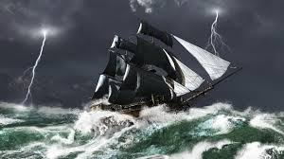
Are You the Master of Your Fate?
When something good happens do you credit your actions or your luck
When something bad happens do you take responsibility or credit it to fate

Slide 6
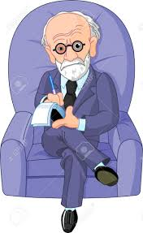
Locus of Control?
Julian Rotter, a behavioural pyschologist, developed the concept of locus of control
People with an external locus of control place responsibility for behavioural consequences on luck, fate, other people etc.
People with an internal locus of control place responsibility for behavioural consequences on their own behaviour and personality characteristics

Slide 7
Video
Discussion
What are the 2 kinds of responses the Israelis could have made?
Why did they respond the way they did?

Slide 8
Conclusion of Exercise
Presentation
Summary of learnings

Slide 9
Can we Change our Locus of Control?
Locus of control is developed through childhood learning, culture and life experiences
Can we unlearn this?

Slide 10
Circles of Control, Influence, Concern
Circle of Control: Situations we can control (situations involving our own behavior)
Circle of Influence: Situations we can influence but not control (situations involving other people’s behavior)
Circle of Concern: Situations that affect us but we can do nothing about (your past, global issues, terrorism)

Slide 11
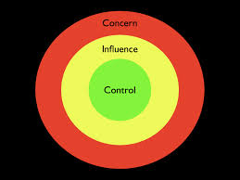
Circle of Control: Situations we can control (situations involving our own behavior)
Circle of Concern: Situations that affect us but we can do nothing about (your past, global issues, terrorism)
Circle of Influence: Situations we can influence but not control (situations involving other people’s behavior)

Slide 12
LARGE GROUP DISCUSSION
What are the courtroom and environment circumstances that make judges feel disempowered?

Slide 13
SMALL GROUP DISCUSSION
For each factor and circumstance that emerged from the large group discussion, divide into small groups and plot the factors in the circles

Slide 14
Conclusion of Exercise
Presentation
Summary of learnings

Slide 15
Effectiveness Through Double-Loop Thinking
RESOURCE PERSON:

Slide 16
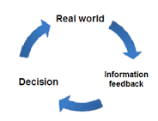
SINGLE LOOP V. DOUBLE LOOP THINKING
Single Loop thinking: what should I do?
Double Loop thinking: why am I doing what I am doing?
Double Loop thinking leads to innovation

Slide 17
SMALL GROUP DISCUSSION
Each group will discuss a scenario and answer the following questions:
What is the goal of this activity I am conducting (in the scenario)
How can I perform the activity in a way that leads to the goal?
Before starting on the discussion, each group will share its goal with the larger audience

Slide 18
Conclusion of Exercise
Presentation
Summary of learnings

Slide 19
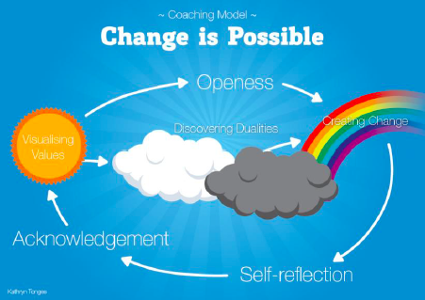
Effectiveness Through Changing our Mindset
RESOURCE PERSON:

Slide 20
DISCUSSION
We see things not as they are but as we are
We believe what we see or we see what we believe

Slide 21
ROLE PLAYS

Slide 22
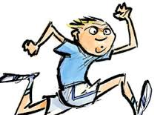
DISCUSSION
Roger Bannister and the 4-minute mile
Is a mindset change critical to success?

Slide 23
FEEDBACK
ERSON:

Slide 24
HANK YOU
ERSON:

